Slide 1

IoT Based Indoor air quality Monitoring SYSTEM
P KISHAN (190049004)
YESWANTH SAI (190040584)

Slide 2
INTRODUCTION
Since we are mostly indoors, we need good air inside a room to stay active.
We have to measure all air quality related parameters like Dust density, CO2, TVOC etc.
All these parameters are displayed on mobile app through IOT
When air quality is less or any volatile gases like methane/H2/LPG detected, we will get an alarm and notified to take precautionary measures
Notifications are sent to mobile app through IOT
Also we can store this data for further analysis

Slide 3
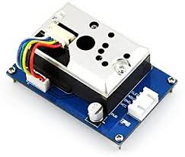
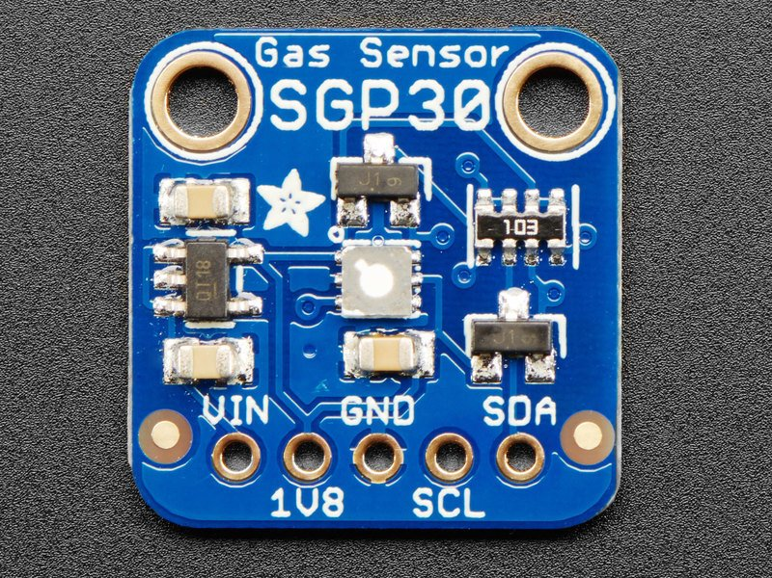
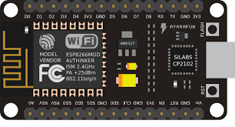
Components used
PM2.5 dust sensor SGP30 Sensor NodeMCU

Slide 4
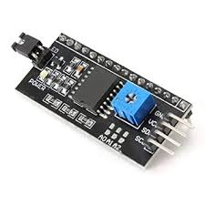
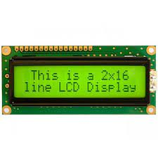
Components used
PM2.5 dust sensor 16x2 LCD display

Slide 5


Software used
Blynk App
Arduino IDE

Slide 6
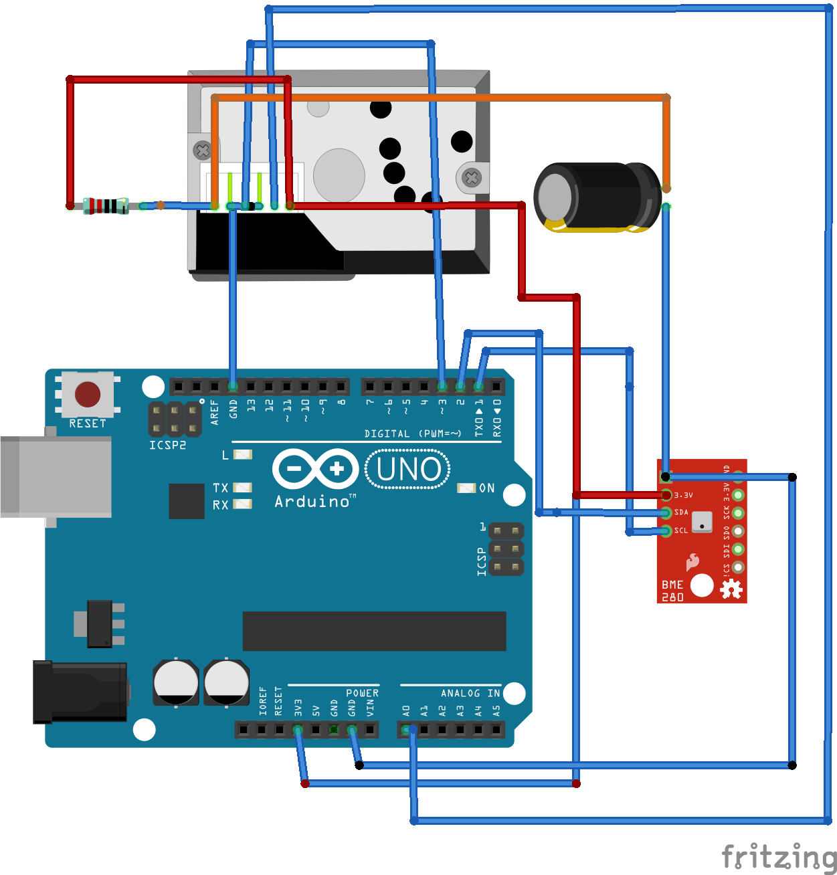
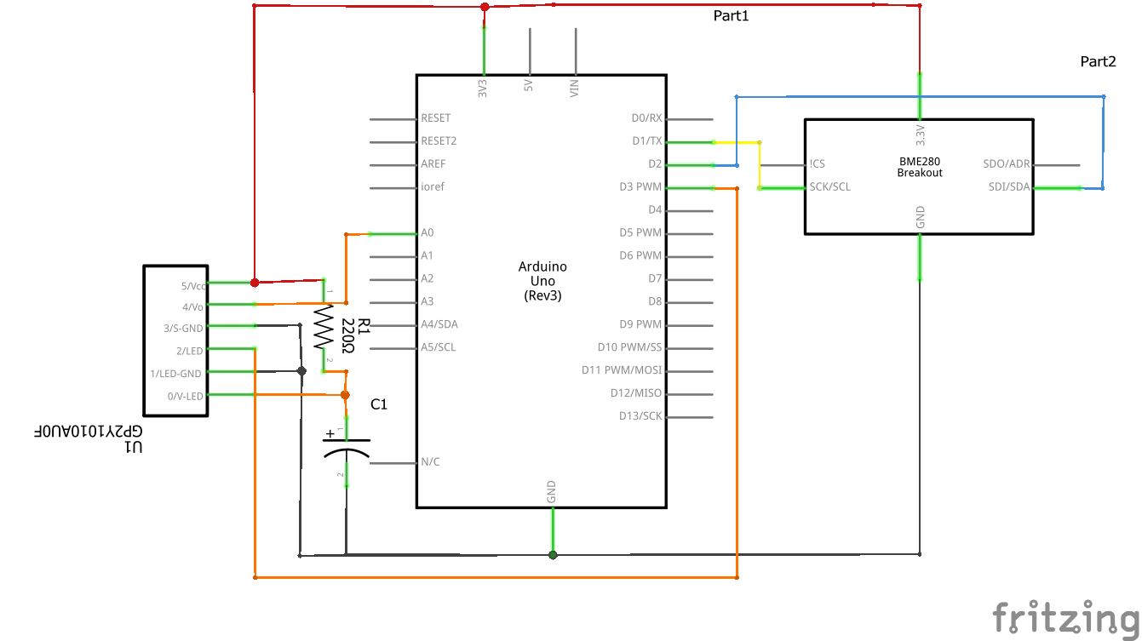
Circuit Diagram (Ignore BME280 )

Slide 7
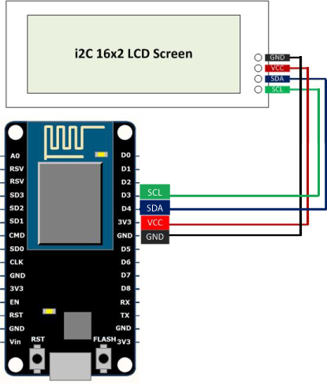
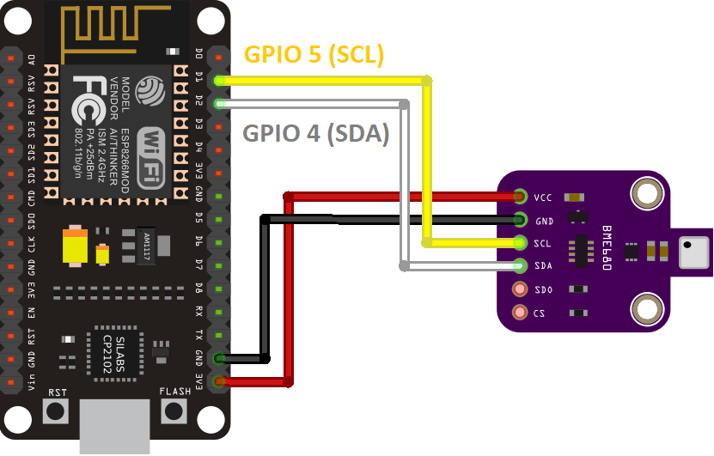
Circuit Diagram

Slide 8
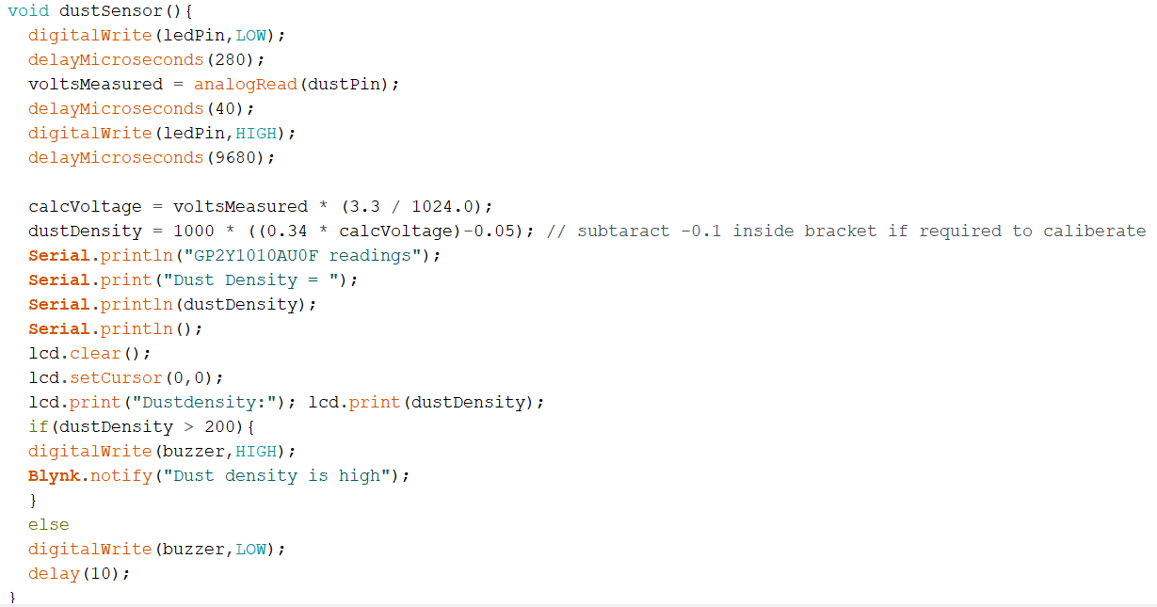
Code

Slide 9
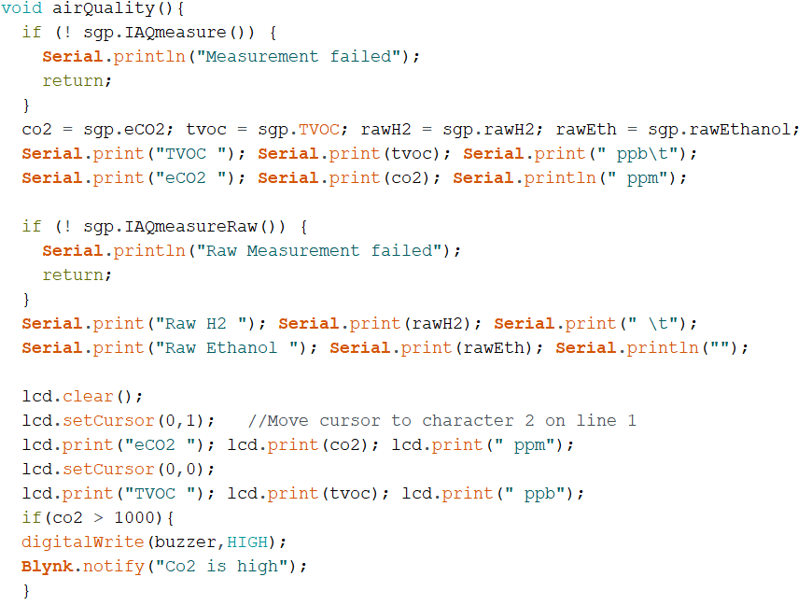
Code

Slide 10
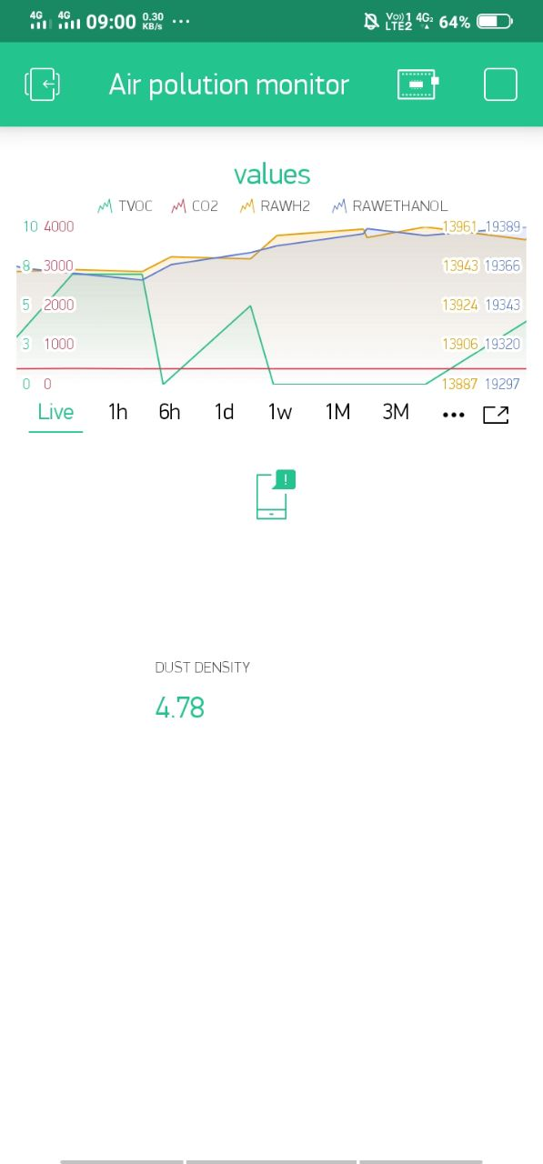
OUTPUT

Slide 11
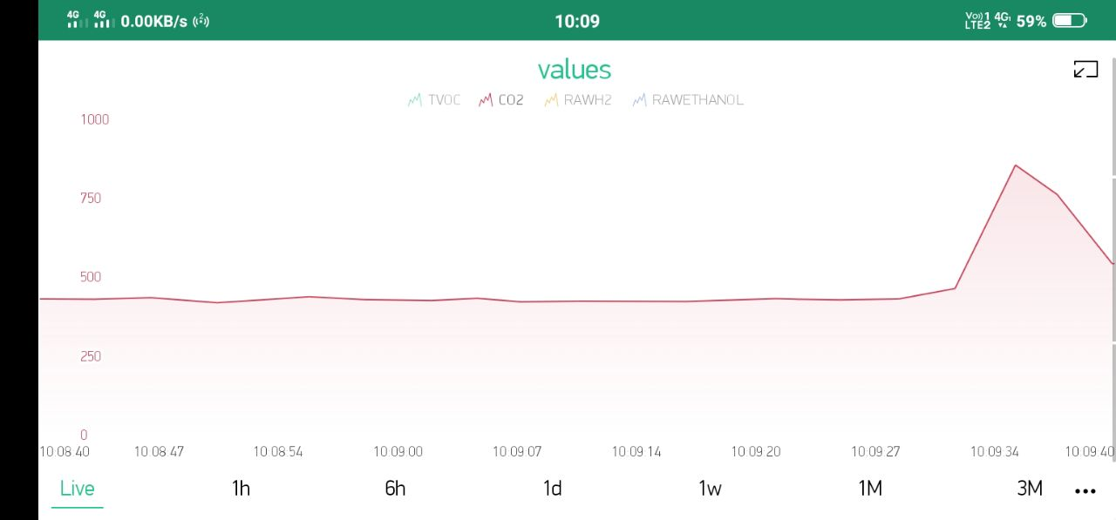

Slide 12
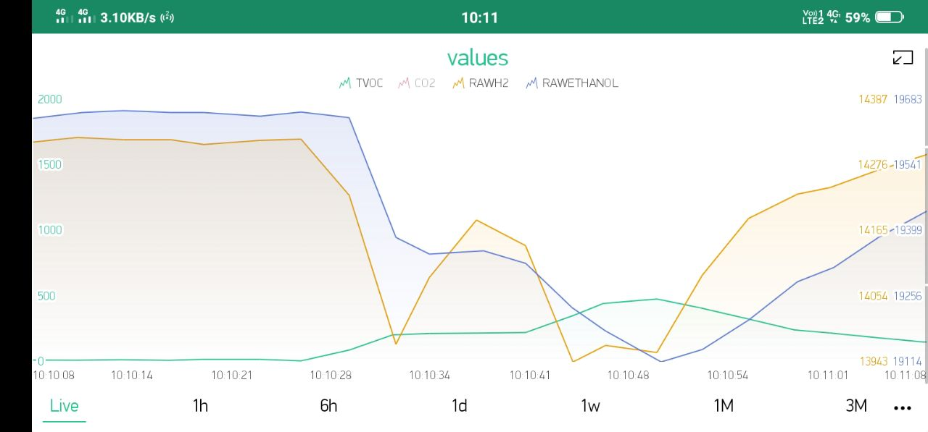

Slide 13
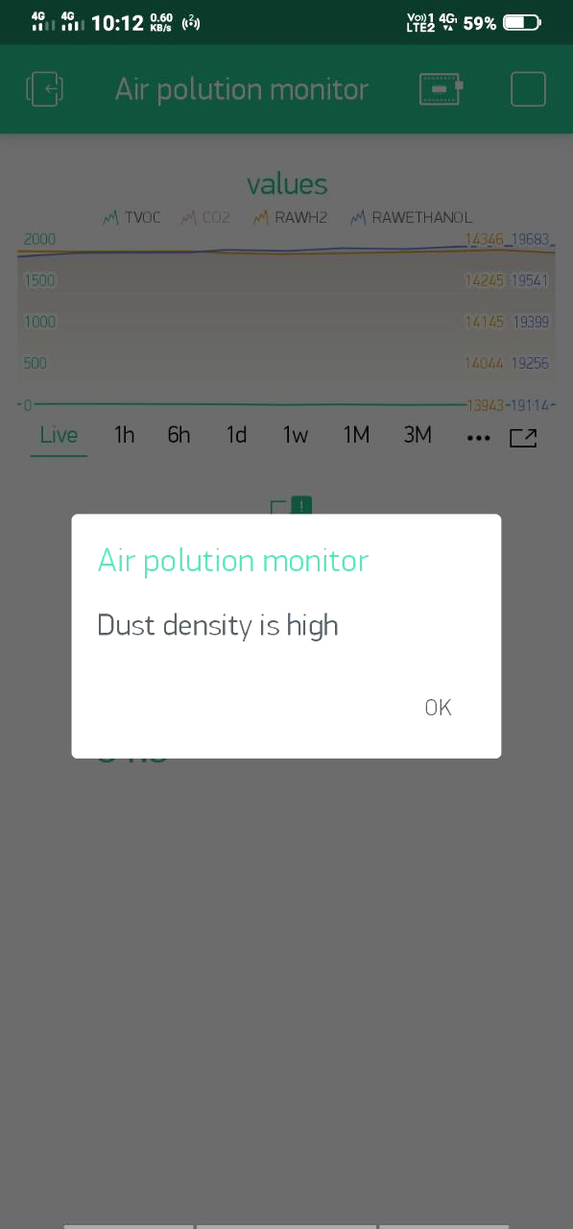
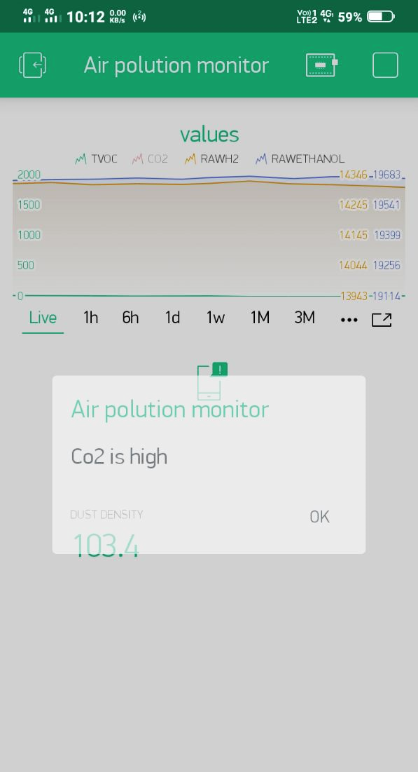

Slide 14
Conclusion
This type of system can be used in our houses to monitor air quality
It can also detect any gas leakage in home like LPG/ any volatile gases
It can detect dust density in air and gives alarm if it exceeds threshold levels
It can be used in Air purifier systems
Overall it can keep a check on air quality in our room.

